Slide 1

The Internet of Things
@n8fr8 @guardianproject @torproject

Slide 2
“Networked sensors and the Internet of Things are projected to grow substantially, and this has the potential to drastically change surveillance. The still images, video, and audio captured by these devices may enable real-time intercept and recording with after-the-fact access. Thus an inability to monitor an encrypted channel could be mitigated by the ability to monitor from afar a person through a different channel.“
BERKMAN CENTER REPORT | FEB. 01, 2016 "DON'T PANIC"
https://cyber.law.harvard.edu/pubrelease/dont-panic/

Slide 3
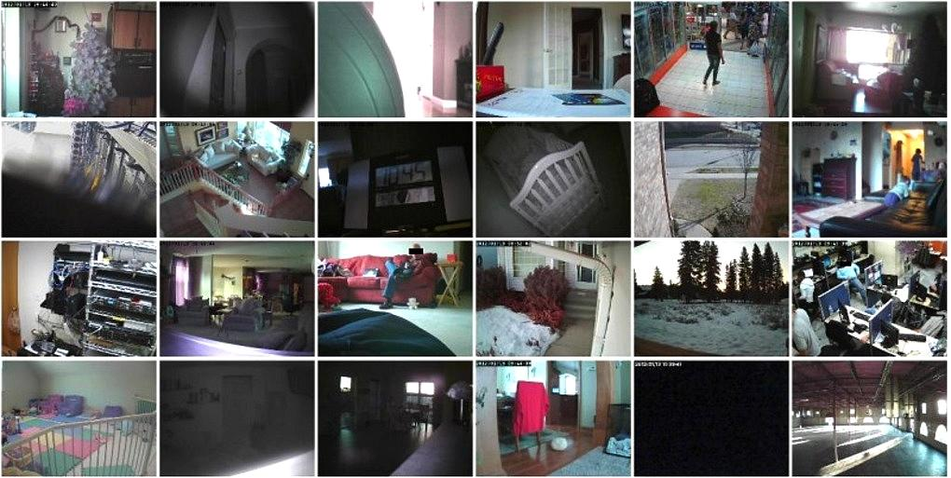
The Crazy Things A Savvy Shodan Searcher Can Find Exposed On The Internet
https://www.shodan.io/ http://www.chip.de/news/Shodan-Suchmaschine-findet-Sicherheitsluecken_61471130.html
http://www.forbes.com/sites/kashmirhill/2013/09/05/the-crazy-things-a-savvy-shodan-searcher-can-find-exposed-on-the-internet/#856386b1f240

Slide 4

Uconnect, an Internet-connected computer feature in hundreds of thousands of Fiat Chrysler cars, SUVs, and trucks... lets anyone who knows the car’s IP address gain access from anywhere in the country.
http://www.wired.com/2015/07/hackers-remotely-kill-jeep-highway/

Slide 5

Jan 6, 2016: Hackers brought down the power supply to hundreds of thousands of homes in Ukraine last week, in a cyber attack believed to be the first ever to result in a power outage.
http://www.ft.com/cms/s/0/0cfffe1e-b3cd-11e5-8358-9a82b43f6b2f.html

Slide 6
Too many “Things” are exposed to the public Internet without the ability to provide strongly confidential and authenticated remote access

Slide 7
There are more “Things” every day.
We must do something now to fundamentally change the way they are being connected to the Internet.

Slide 8
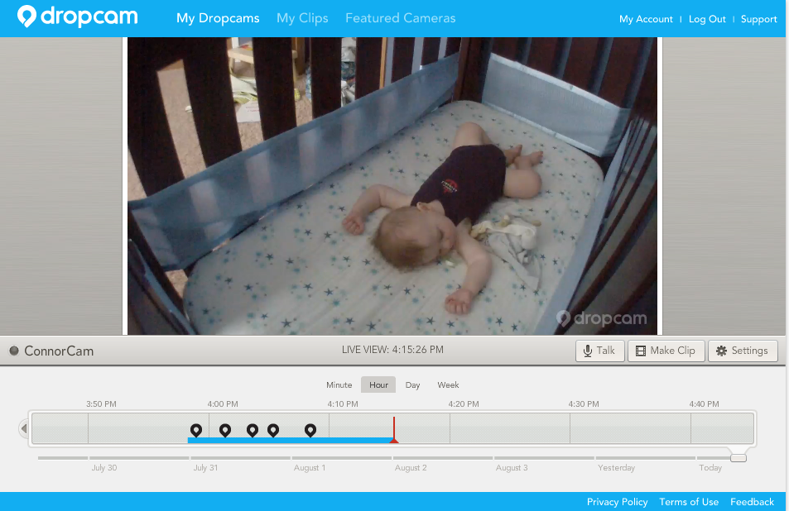
DIRECT CONNECT (BAD)
you, out in the world
your abode
your tiny human thing
UPNP + DynDNS
the very public internet
HTTP / RTSP
your cam thing
You connect to Your Thing via Direct Internet Address Through Open Firewall Port
(usually without encryption and often with default passwords)

Slide 9
Have you seen what is waiting for you outside your router?
“they are coming to get you…”

Slide 10
CLOUD SYNC (MORE SECURE, LESS PRIVATE)
you, out in the world
your abode
your tiny human thing
the very public internet
HTTPS
HTTPS
your cam thing
You connect to Your Thing through a Cloud Service
(which then knows all, remembers all, and happily shares and/or monetizes all)

Slide 11
Why continue to rely on the flawed models and implementations of TLS and Certificate Authorities, when the shift to Things means we can do more?

Slide 12

ONION ROUTED (BEST!)
you, out in the world
no data
sad cloud :(
your abode
Onion
Service
your tiny human thing
Tor: confidential, authenticated, obfuscated
Tor
the very public internet
Tor
your cam thing
Tor
Tor
Tor
Client / Browser
sad haxxors :(
You connect to Your Thing through Tor as an Onion Service
(nobody knows who you are connecting to or what you are seeing except you)

Slide 13
Tor can safely “poke holes” in firewalls to connect you to peers, but does so with a very complicated and real threat model in mind

Slide 14

you, out in the world
no data
sad cloud :(
Onion
Service
Tor: confidential, authenticated, obfuscated
Tor
the very public internet
Tor
your car thing
Tor
Tor
Tor
Browser
sad haxxors :(
You connect to Your Thing through Tor as an Onion Service
(nobody knows who you are connecting to or what you are seeing except you)

Slide 15

you, out in the world
no data
sad cloud :(
Onion
Service
Tor: confidential, authenticated, obfuscated
Tor
the very public internet
Tor
your public utility thing
Tor
Tor
Tor
Browser
sad haxxors :(
You connect to Your Thing through Tor as an Onion Service
(nobody knows who you are connecting to or what you are seeing except you)

Slide 16
Unroutable!
?
Tor
Client WITHOUT
Auth Cookie
Onion
Service w/ Auth Cookie
Tor
Tor
Tor
Tor
Tor
Tor
Client WITH Auth Cookie
Onion (or “Hidden”) Services can even hide the fact they exist at all, if you don’t know the necessary cookie. With Onion Authentication, you can’t crawl or probe.

Slide 17
What if we built an Onion-secure home webcam or baby monitor device?

Slide 18
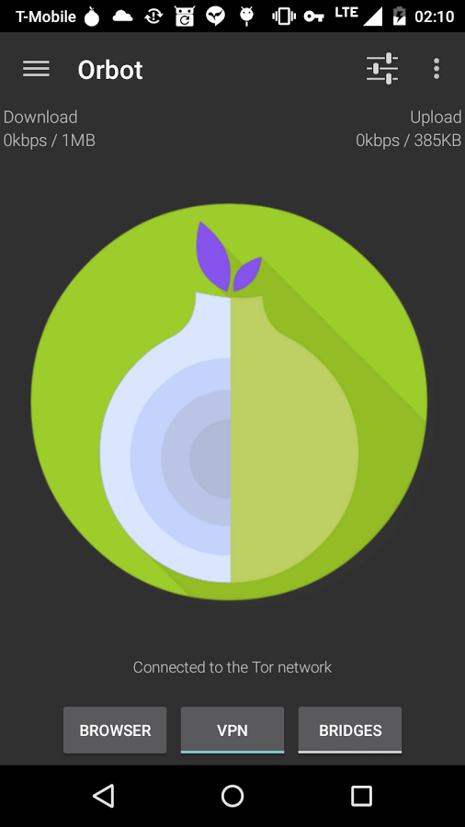
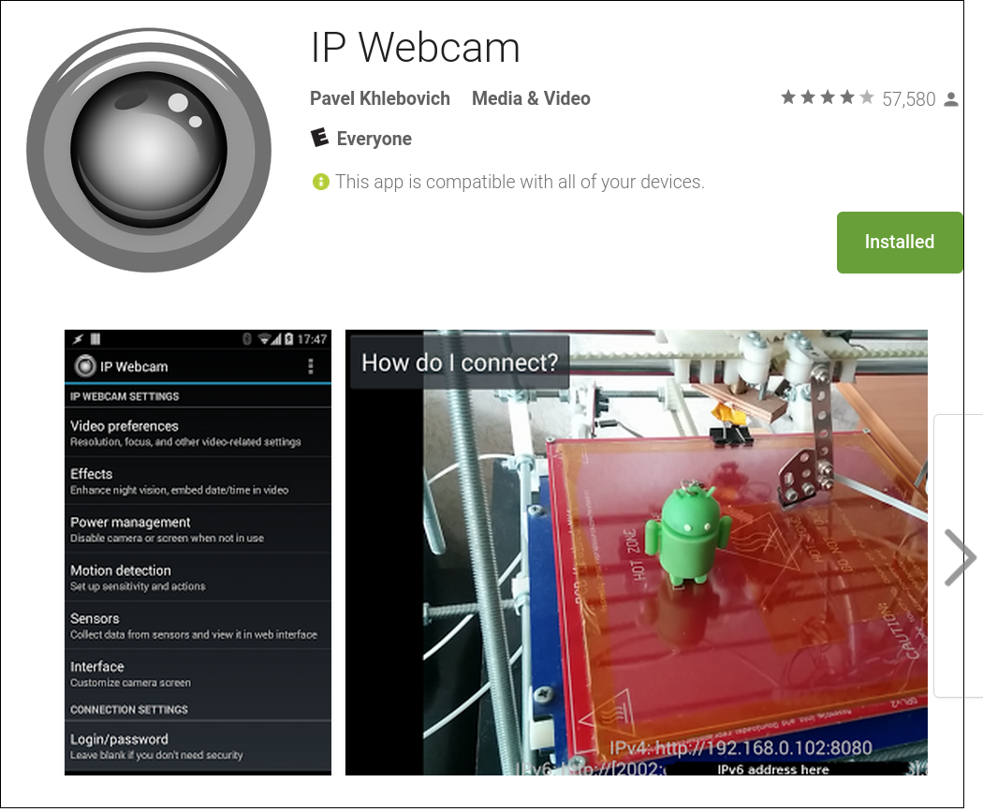
+
= OnionCam for Android!
(available now with just a few steps of setup!)

Slide 19
OnionCam: Quick How To
Install Orbot
Enable Orbot Settings->Hidden Service Hosting
Enter “8080” into Orbot Settings->Hidden Service Ports
Start/Restart Orbot
Find your new Onion hostname in Orbot Settings->.Onion Hostname
Install IP Webcam app (Free or Pro)
Set a username/password for the IP Webcam server!
Start IP WebCam
Go to http://yourdotonion:8080 in Tor Browser
Optional: enable VLC to work over Tor and open network stream: http://yourdotonion:8080/video

Slide 20
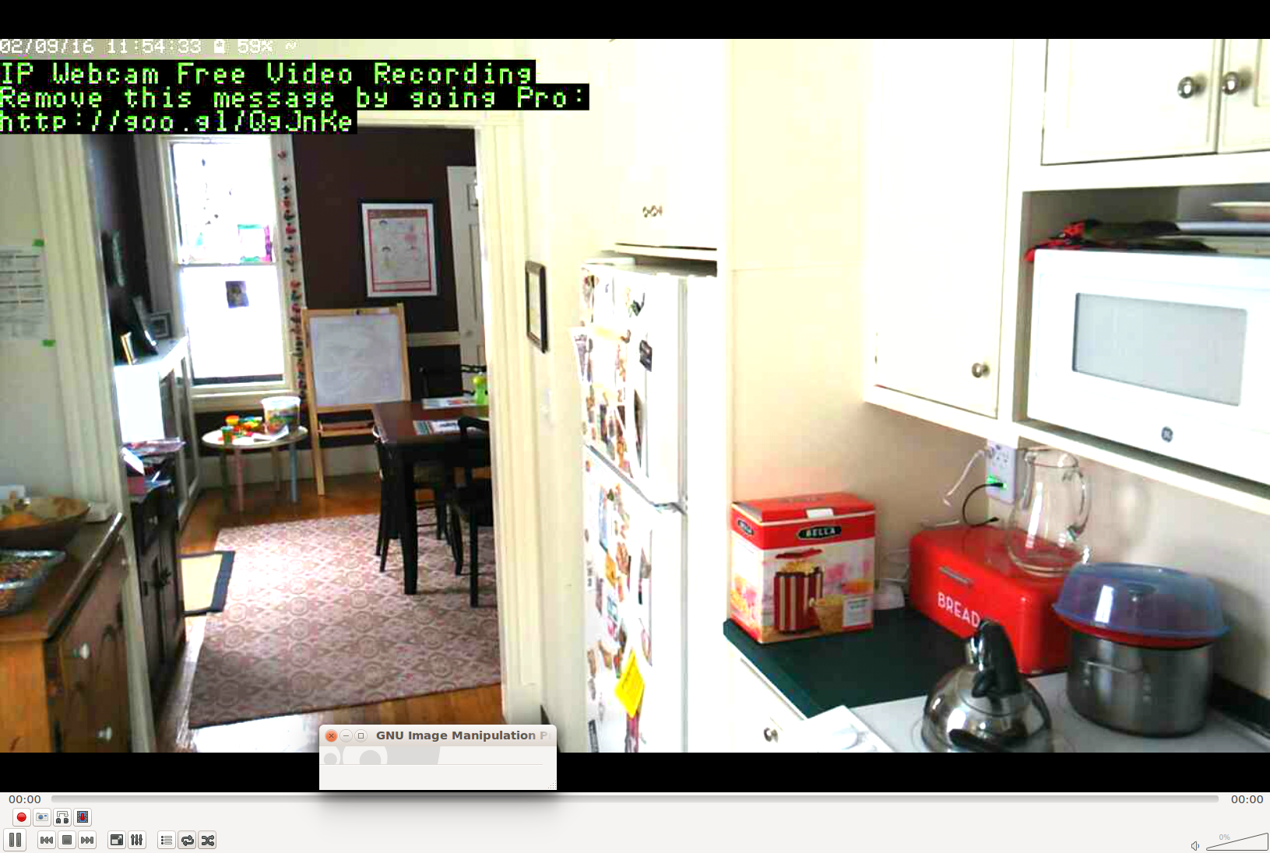
OnionCam in my Kitchen… everything is safe and sound!
Access via Tor Browser at http://<myprivateaddress>.onion:8080 or via VLC RTSP video streaming via rtsp://myprivateaddress.onion:8080/video

Slide 21
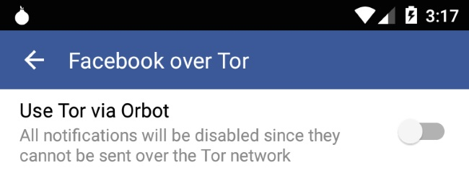
Using the NetCipher Library for Android, anyone can build in Onion Service support right into apps like IP WebCam and WebCam viewer apps to make the OnionCam a reality today.
This is what Facebook did to add Tor support into their Android app:
https://guardianproject.info/code/netcipher

Slide 22
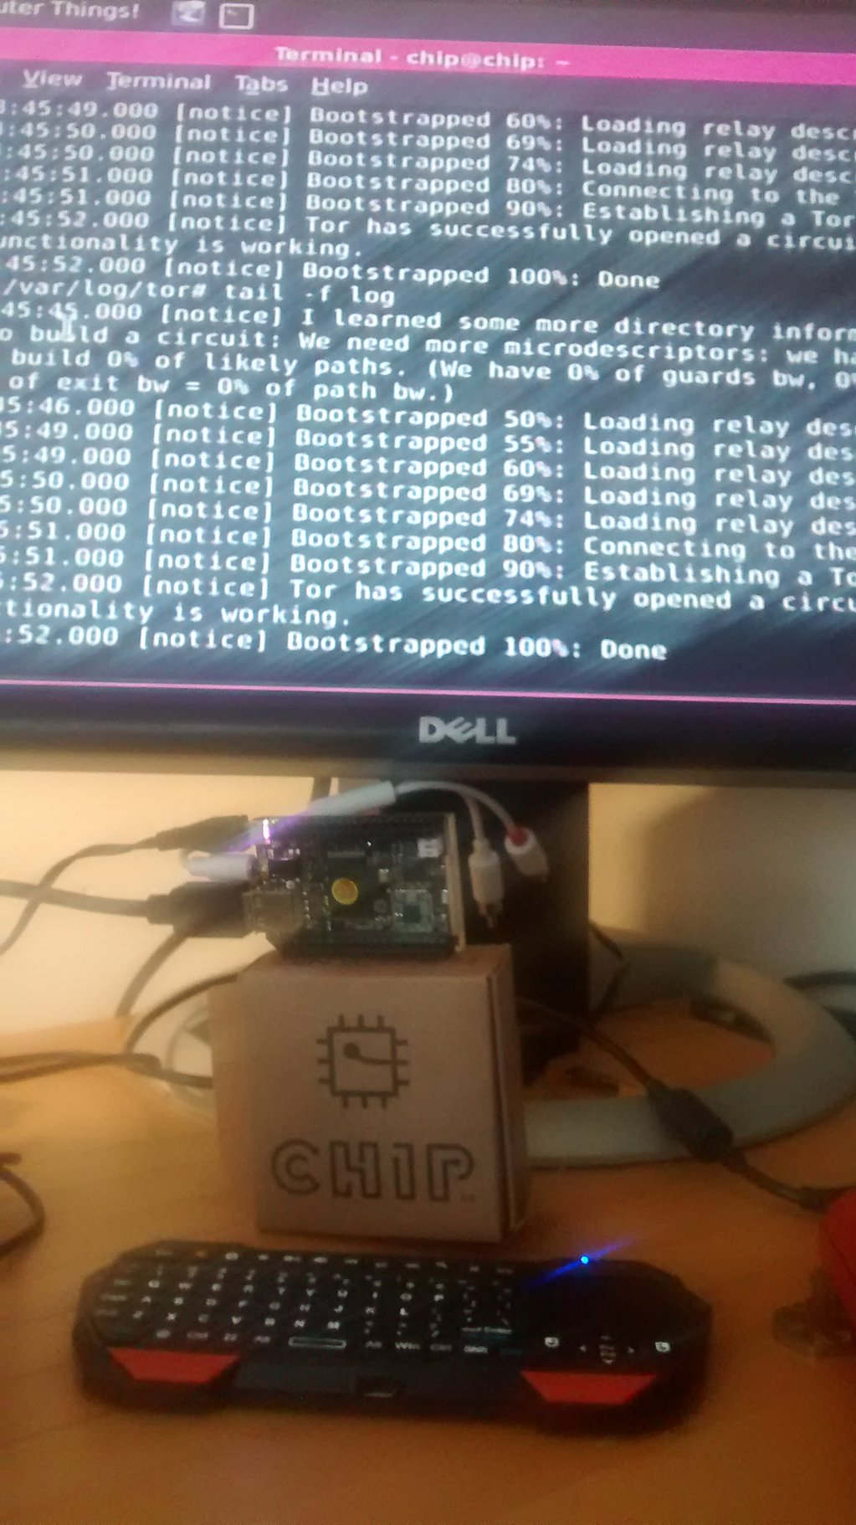
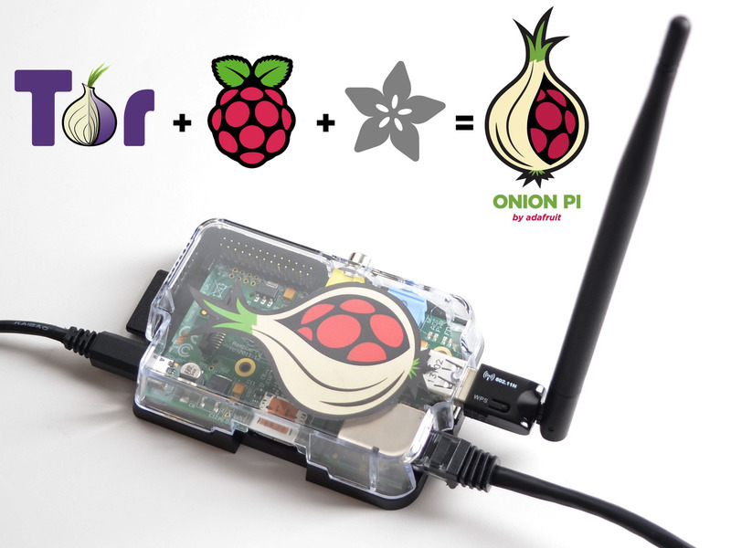

AdaFruit OnionPi for $59
Tor can run on, and be built into,
really cheap Things! It just requires
some form of Linux and an ARM chip.

Slide 23
Tor Onion Services addresses both the needs and threats of IoT
It provides direct connectivity between you and your things, or things and other things, without sacrificing confidentiality and authentication, or compromising your broader network security
It has built-in resistance to unauthenticated probing and access, and decouples specific Internet address from specific devices or services
It is 100% free and open-source, scrupulously engineered,designed to withstand the threat of nation state grade actors, and available NOW

Slide 24
The Internet of Things:
Hopefully coming soon to a webcam, baby monitor, car, power plant, thermostat, toaster, television, toilet, drone, health tracker and anyotherkindofthing near you!
@n8fr8 @torproject and more at https://torproject.org

